Slide 1


FOI Submission for Campaign Analyst River Action UK BY
Michael Omas

Slide 2
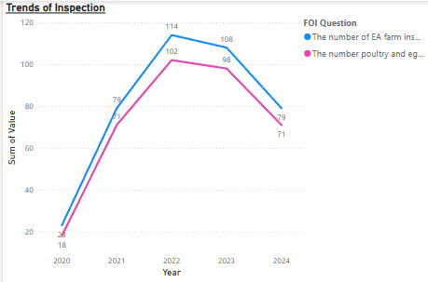
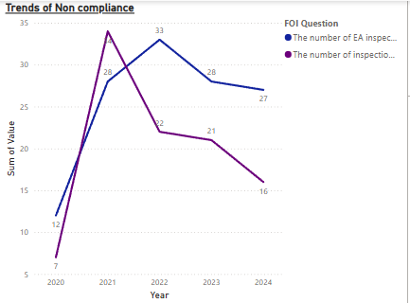
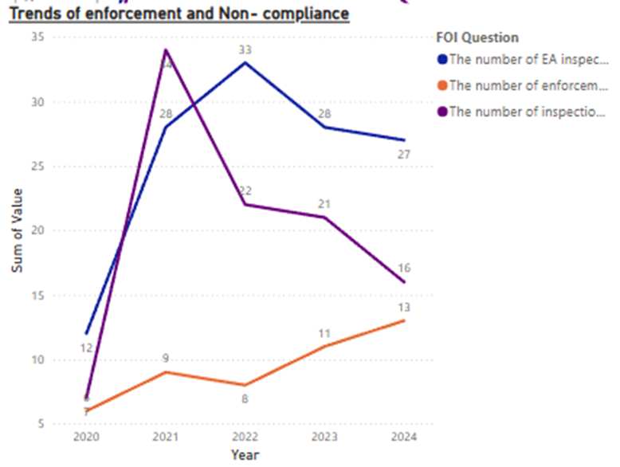
Data Review
Trends in Inspections
General Increase, Then Decline:
The number of EA farm inspections on permitted poultry and egg sites rose significantly from 23 in 2020 to 114 in 2022, before declining in 2023 (108) and further dropping to 79 in 2024.
A similar pattern is seen in Red Tractor-certified farm inspections, peaking in 2022 (102) and declining to 71 in 2024.
Non-Compliance Trends:
The number of inspections identifying non-compliance increased from 12 in 2020 to 33 in 2022 but then declined slightly in 2023 (28) and 2024 (27).
Red Tractor-certified farms also saw fluctuations in non-compliance cases, peaking at 34 in 2021 but decreasing over time (16 in 2024).
Enforcement Actions Remain Low:
Enforcement actions for non-compliance have remained consistently low, with only 6 actions in 2020, reaching a peak of 13 in 2024, despite a high number of non-compliance findings.
This suggests a gap between identifying violations and taking regulatory action.
Gaps and Inconsistencies in Data.
Declining Inspections Post-2022: The drop in inspections after 2022 may indicate budget constraints, policy shifts, or reduced enforcement priorities.
Inconsistent Enforcement Actions: Despite finding non-compliance in a significant number of cases, the number of enforcement actions remains disproportionately low.

Slide 3
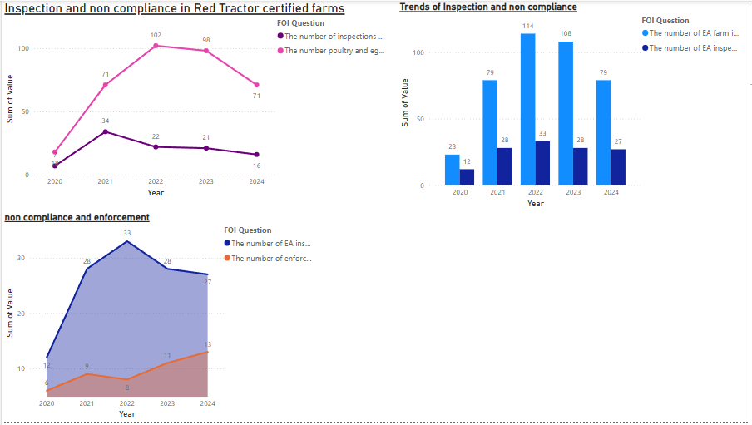
Insights
Inconsistent Oversight & Declining Inspections:
After a peak in 2022 (114 inspections), inspections have steadily declined (79 in 2024), despite ongoing non-compliance issues.
Messaging for Advocacy: This suggests a potential weakening of regulatory oversight, which could be emphasized in media and public campaigns to push for greater enforcement resources.
Low Enforcement Despite Non-Compliance Findings:
While non-compliance was identified in 27 cases in 2024, enforcement actions were only 13, meaning nearly half of the violations did not result in action.
Messaging for Advocacy: This could be framed as a failure to hold polluting farms accountable, weakening the deterrent effect of inspections. Campaigns could call for stronger penalties and enforcement mechanisms.

Slide 4
Recommendation
Recommendations for Next Steps
Push for Increased Inspections & Budget Transparency
Advocate for higher inspection rates and more funding for the EA to ensure farms comply with environmental laws.
Strengthen Enforcement & Penalty Systems
Pressure policymakers to increase fines, enforcement actions, and legal consequences for non-compliant farms.
Expose Weaknesses in Red Tractor Certification
Conduct investigations into Red Tractor farms, questioning whether the scheme adequately protects the environment.
Gather More Data on Pollution Impacts
Work with environmental researchers to track water quality trends alongside farm inspections.

